Slide 1
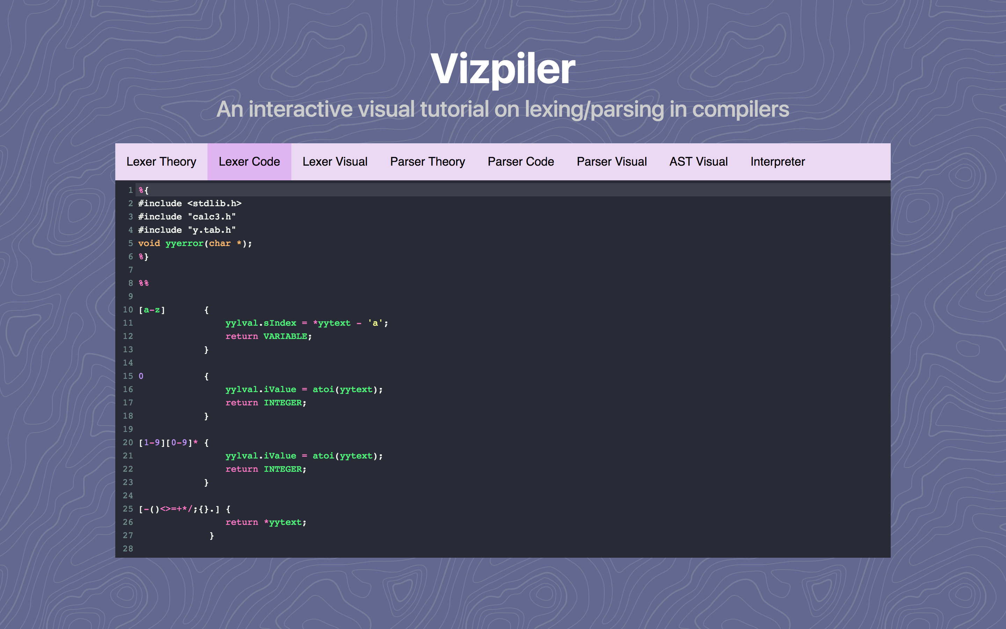
To see the prototype (that doesn’t do anything yet): goo.gl/jKzfIF

Slide 2
What is Vizpiler?
Interactive tool for visualizing how compilers work
Three sections for each part:
Theory
Code
Visualization
Steps in a compiler:
Lexical analysis (also called lexing)
Parsing and Abstract Syntax Tree (AST) generation
Code generation (not covered in Vizpiler, instead we have an interpreter)

Slide 3
Lexing
Reading a sequence of characters and determining what tokens are being expressed
Example¹: foo = 1– 3**2
Lexeme | Token Type
foo | Variable
= | Assignment Operator
1 | Number
- | Subtraction Operator
3 | Number
** | Power Operator
2 | Number
1. From https://www.cs.wmich.edu/~bhardin/cs4850/flexbison.pdf

Slide 4
Lexing
How does it work? What’s the algorithm?
Based on converting regular expressions to a combined DFA
There is an open-source tool called flex that does this for us

Slide 6
Parsing
Reading a sequence of tokens and building a tree of how they should be recursively interpreted
Interpretation is called a “grammar”
Can be expressed in “Backus-Naur form” or BNF
Simple BNF example for mathematical expression (see recursion!)
<exp> ::= <exp> + <exp>
<exp> ::= <exp> - <exp>
<exp> ::= <exp> * <exp>
<exp> ::= <exp> / <exp>
<exp> ::= <number>

Slide 7
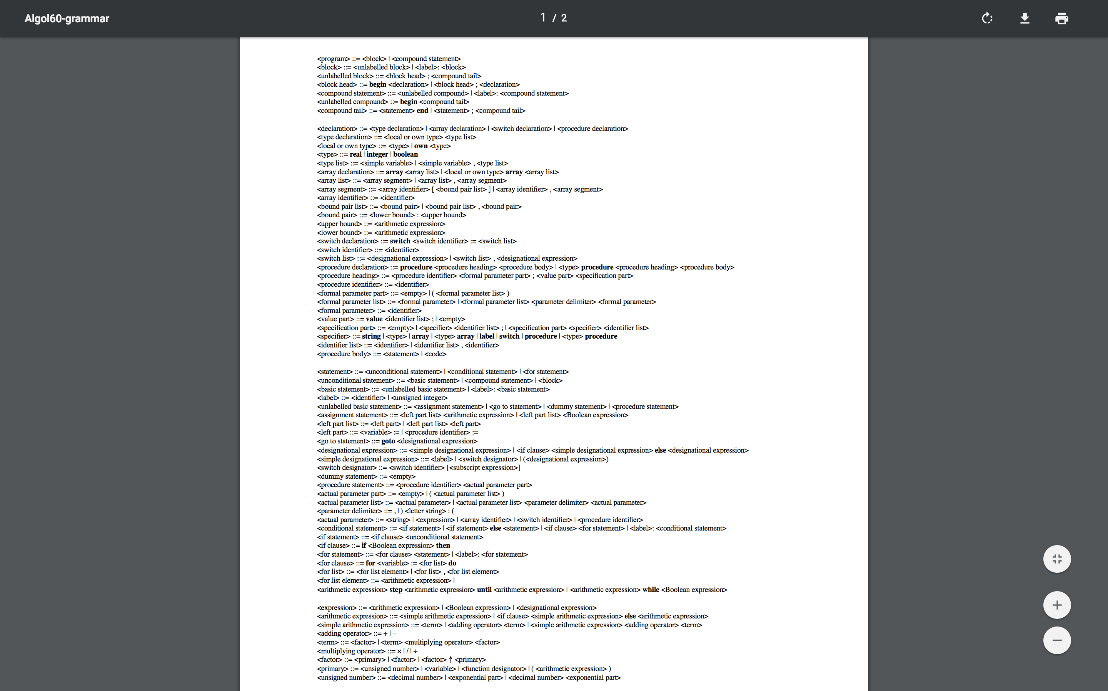
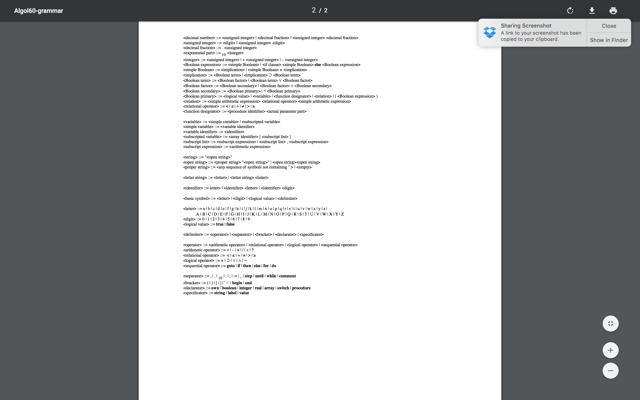
Algol-60 BNF
Can get very involved!

Slide 8
Parsing
How does it work? What’s the algorithm?
More complicated than lexing
Also uses a DFA, but the states and transitions are determined by LR(1) parsing algorithm
A tool called bison can build the DFA for us
See my tutorial when it’s complete for more info if you’re interested!!! (I will post it on the Piazza page) ☺
The parser parses the expression into an Abstract Syntax Tree (AST) which can be used for code generation

Slide 11
What VP does
Allows you to learn about and build a programming language in-browser
Code is sent to Node.js server and compiled (am working on this currently)
FSM diagrams are returned to user for visualization!
If I have enough time/interest, I will add one or more of the following features:
Visualize the AST
Step through the FSM states
Sandbox the compilation process on the server/create access control to make sure server resources are not abused
Permanently host the server somewhere (AWS)

